Slide 1

Process optimization in FSW of two similar γ-TiAl alloys using ML approach
20120015 Ankam Ravi Varma
20120024 Kiran Kumar Challa
20120062 Nimmaka Meghana
20120103 Vallepu Prabhu Das
19120062 Panjala Samanvitha
Project Viva
Supervised By:
Dr. Naga Sruthi Neelam
Department of Metallurgical and Materials Engineering
National Institute of Technology
Raipur – 492 010

Slide 2

Contents
INTRODUCTION
TiAl alloys
Friction stir welding
Machine Learning
OBJECTIVE
METHODOLOGY
RESULTS AND DISCUSSIONS
SUMMARY & CONCLUSION

Slide 3
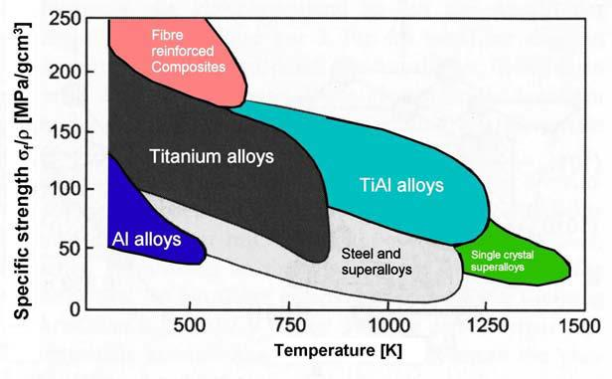
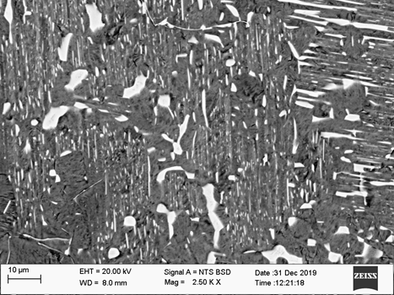
γ-TiAl alloys:
Why γ-TiAl alloys?
Weight reduction
Substantial reduction in CO₂ and NO_{x} emission.
Substantial noise and cost reduction.
Gamma TiAl based alloy Concepts
γ-TiAl alloys possess low specific weight (ρ=3.9 gm/cm³)-leads to substantial weight saving
High Elastic Stiffness (E=170 GPa)
Good oxidation resistance up to 750°C
High tensile strength and fatigue strength
β/Β2
lamellar
α₂+γ
γ-Ti-46.5Al-5Nb-2Mo-0.3B

Slide 4
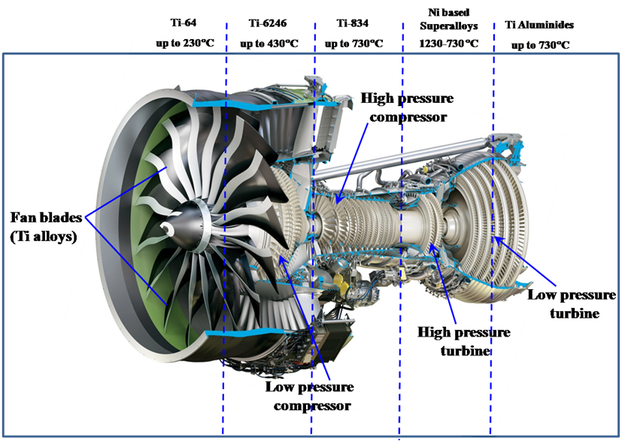
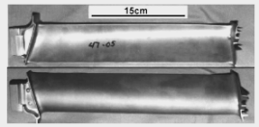
Applications:
Aerospace and automotive applications
Blades
Courtesy: GE aviation

Slide 5
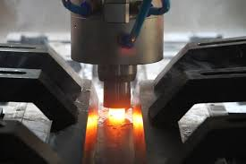
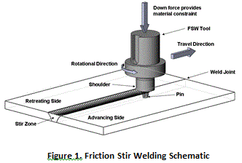
Friction Stir Welding (FSW):
What is FSW?
Solid state joining process
A non-consumable rotating tool is used to generate frictional heat between the tool and the materials leading to material mixing for a metallurgical and mechanical bonding at the interface
WHY?
Economic, effective and relatively productive
No requirement of vacuum, shield gas, filler materials etc.

Slide 6
Current Status of Work
Inherent brittleness; high dependence of properties on structure and composition of γ-TiAl alloys
Challenging to control the metallurgy of the material and to prevent cracking during welding
Joining Method | Limitation
Friction stir welding | Solid state cracking
Diffusion bonding | Brittle α₂ phase along the bond line degrading the mechanical properties
Laser/Electron beam | High thermal stresses; α-γ phase transformation
Use of interlayers | Compromising the composition of the material
Careful optimization of welding parameters, preheating to 700–800 °C, etc.
Joining of Gamma-based Titanium Aluminides – A Review: A. S. Ramos et.al., Materials Science Forum Vols. 514-516 (2006) pp 483-489
The joining of gamma titanium aluminides via the powder interlayer bonding method; Davies, P.D., Davies, H.M., Watkins, I. et al.; Int J Adv Manuf Technol 109, 2049–2054 (2020)

Slide 7

Machine Learning
Machine learning is like teaching computers to learn from data and make decisions without being explicitly programmed for each task.
It's about creating algorithms that can recognize patterns and make predictions or decisions based on examples or experiences.

Slide 8
Machine Learning in FSW
Machine learning is increasingly being used in various aspects of Friction Stir Welding (FSW) to enhance the process, improve quality control, and optimize parameters.
Here are some ways in which machine learning is applied to FSW:
Quality Control
Process Optimization
Anomaly Detection
Predictive Maintenance
Material Selection
Weld Parameter Optimization
Simulation and Design.
Data Analysis.
Y. Du, T. Mukherjee, P. Mitra, T. DebRoy, Machine learning based hierarchy of causative variables for tool failure in friction stir welding, Acta Materialia, Volume 192, 2020, Pages 67-77,

Slide 9
Research Objectives:
Optimization of FSW parameters to obtain a defect free joint of γ-Ti-46.5Al-5Nb-2Mo-0.3B alloy using Machine learning
To generate sufficient data set for Machine learning process
Optimization of process parameters using various ML algorithms – to reduce the experimental trails in obtaining a defect free joint

Slide 10
Process parameters of FSW for ML:
Rotation Speed
Traverse Speed
Tool Geometry
Plunge Depth
Friction Time
Upset Pressure
Friction Pressure
Tilt angle
Independent Variable.
Rotation Speed
Friction Time
Upset Pressure
Friction Pressure
Tilt angle
And Output Variable
Tensile Strength
Y. Du, T. Mukherjee, P. Mitra, T. DebRoy, Machine learning based hierarchy of causative variables for tool failure in friction stir welding, Acta Materialia, Volume 192, 2020, Pages 67-77,

Slide 11
Methodology
DATA COLLECTION
Assembled a dataset by reviewing literature and extracting sample data from research journals.
The defined ranges of each parameter were sourced from these journals.
Tensile Strength ranges from 120-450 MPa
PROCESS PARAMETER | RANGE
Rotational Speed | 2000-2500 rpm
Friction Time | 30-50 sec
Upset Pressure | 300-460 MPa
Friction Pressure | 130-170 MPa
Tilt Angle | 1- 3 ⁰
Microstructure and Mechanical Properties of Ti-48Al-2Cr-2Nb Manufactured Via Electron Beam Melting DO - 10.1002/9781119296126.ch223
Joining Technology of gamma-TiAl Alloys By Sonia Luisa dos Santos Simoes, Filomena Maria da Conceicao Viana, Manuel Fernando Goncalves Vieira

Slide 12
Methodology
2) IMPLEMENTATION OF MACHINE LEARNING ALGORITHMS
Importing the python libraries
Loading the FSW data set
Exploratory data analysis on FSW data set
Splitting the data set
Implementation of ML algorithms
Evaluation of ML Models
Y. Du, T. Mukherjee, P. Mitra, T. DebRoy, Machine learning based hierarchy of causative variables for tool failure in friction stir welding, Acta Materialia, Volume 192, 2020, Pages 67-77,

Slide 13
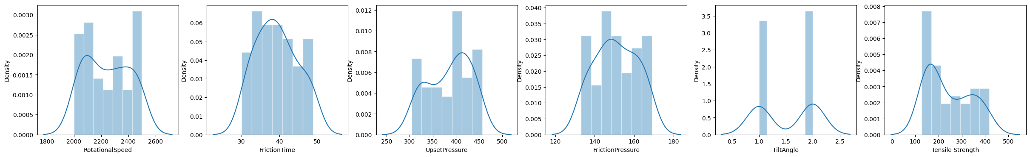
Exploratory Data Analysis

Slide 14
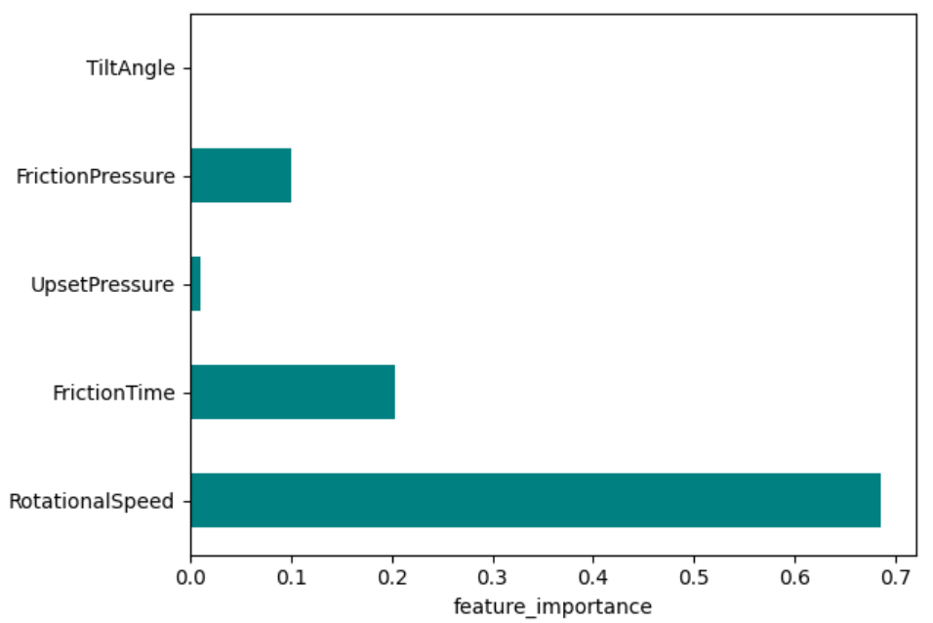
Feature Importance
It is observed that the Rotational Speed (RPM) has the highest influence on the nature of TS (MPa).
Tilt Angle does not influence much on the nature of TS (MPa).

Slide 15
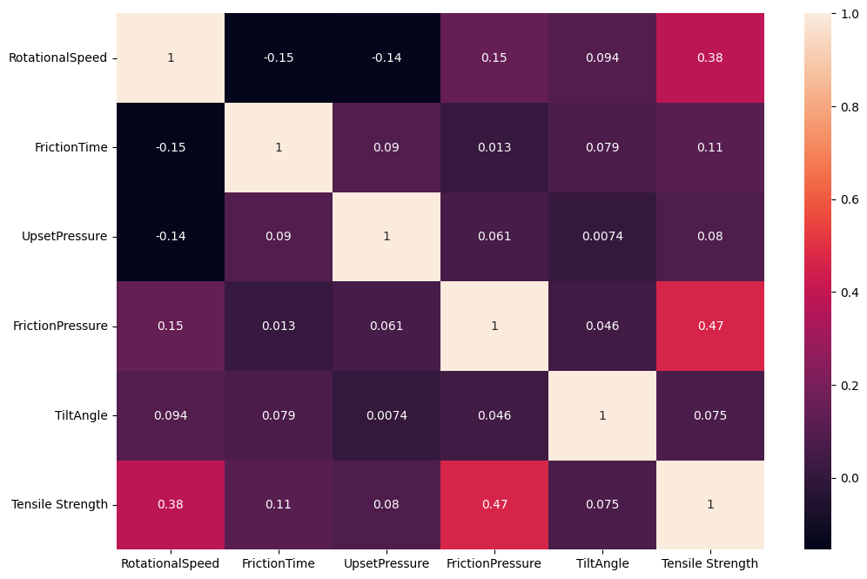
Correlation between the Variables

Slide 16

Results and Discussion
Decision Tree Algorithm
Decision Tree is a greed-based non-parametric machine learning algorithm used to predict the target variable, i.e., Tensile Strength.
The Decision Tree model performed well, explaining 86.5% of the outcome's variation (R-squared) and showing small prediction errors (MAE) with a value of 28.189.

Slide 17
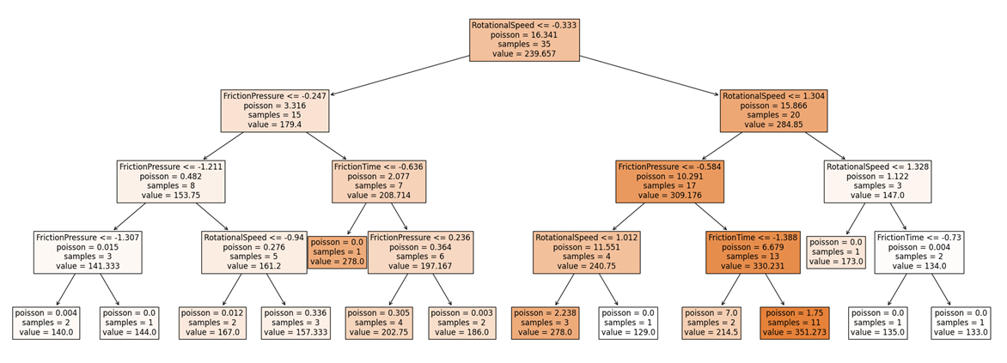
Decision Tree Architecture

Slide 18
Random Forest Algorithm
Random Forest algorithm is a supervised machine learning algorithm constituted from decision trees.
The predicted output is generated by the outcome resulted from the decision trees by taking the mean or average of the output yielded from the individual decision trees.
The Random Forest model did well, explaining 84.5% of the result, and it made accurate predictions with a small error (MSE: 34.481)

Slide 19
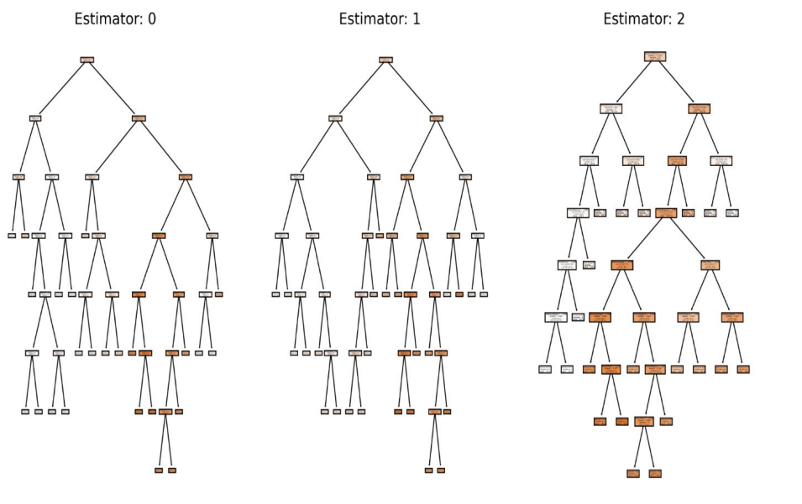
Architecture of Random Forest Algorithm

Slide 20
Gradient Boosting Algorithm
Gradient Boosting algorithm is an ensemble model that combines the weal learners or weak predictive models to predict the continuous value further.
It is observed that the Gradient Boosting Algorithm results the best fit by yielding the highest value of 0.890 in comparison to the other two algorithms.

Slide 21
Optimized Parameters
Rotational Speed | Friction Time | Upset Pressure | Friction Pressure | Tilt Angle | Tensile Strength
2309 | 35 | 412 | 159 | 1 | 418(MAX)
2480 | 31 | 319 | 137 | 1 | 127(MIN)
Custom Inputs -
Rotational Speed- 2000 rpm, Friction Time – 42 s, Upset Pressure-411 MPa, Friction Pressure-139 MPa, Tilt Angle- 2°
Predicted Output – 160.17 MPa
Actual Output – 157 MPa

Slide 22
Summary and Conclusions
Data set required for ML process is obtained from the literature and expanded using various mathematical algorithms
Supervised machine learning regression-based algorithms, including Decision Trees, Gradient Boosting Algorithm, and Random Forest Algorithm, using Python programming were implemented
Highest and least tensile strength of 418 MPa and 127 MPa respectively was achieved for the alloy γ-Ti-46.5Al-5Nb-2Mo-0.3B under specific parameter settings
These results can be taken as a guideline and be validated with the experimental setup for joining similar γ-Ti-46.5Al-5Nb-2Mo-0.3B alloys using FSW to obtain defect free joints

Slide 23
Thank you

